Slide 1
JavaScript engines. The V8 engine.
Albert Hovhannisyan

Slide 2
What is the engine?

Slide 3


SpiderMonkey

Slide 4

Chakra

Slide 5



Slide 6
SOURCE CODE
PARSER
COMPILER
FULLGODEGEN
HALF-OPTIMIZED
CODE
2008

Slide 7
WHY WE NEED PARSER?
SOURCE CODE
Abstract Syntax Tree

Slide 8
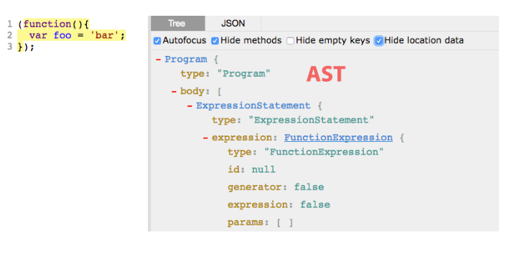
WHAT IS AN AST?

Slide 9
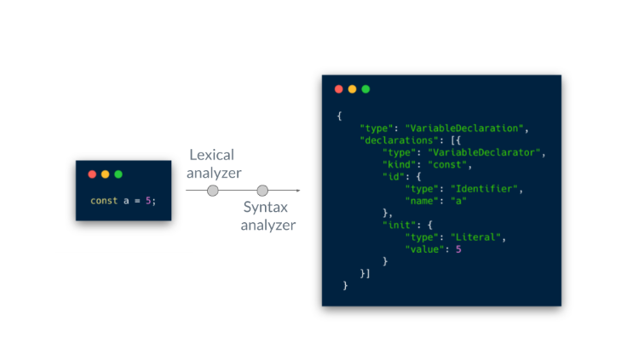
AST GENERATION

Slide 10
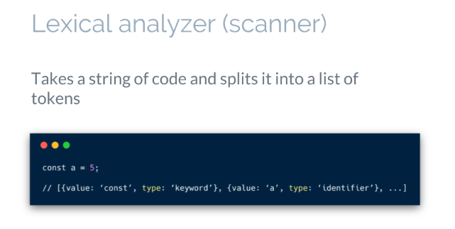
AST GENERATION

Slide 11
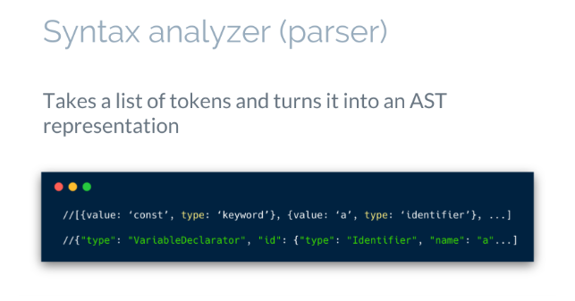
AST GENERATION

Slide 12
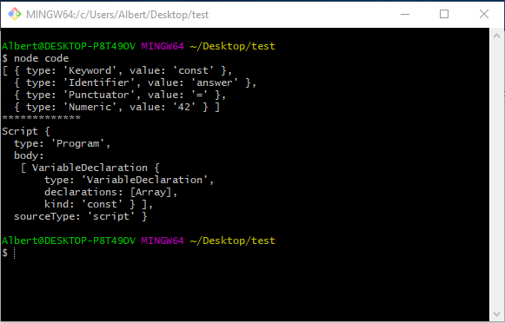
TRY ESPRIMA

Slide 13
Two types of compilation
Ahead of Time (AoT)
Just In Time (JIT)

Slide 14
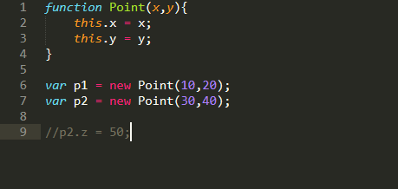
Hidden Classes
Hidden class point
Hidden class point2
Hidden class point3

Slide 15
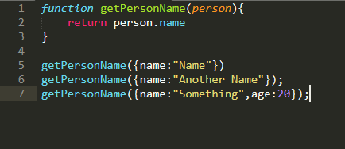
Inline caching

Slide 16
SOURCE CODE
PARSER
FULLCODEGEN
NON-OPTIMIZED CODE
PARSER
CRANKSHAFT
OPTIMIZED CODE
2010

Slide 17
SOURCE CODE
PARSER
FULLCODEGEN
NON-OPTIMIZED CODE
PARSER
CRANKSHAFT
OPTIMIZED CODE
TURBOFAN
2015

Slide 18
Optimization killers
Generators and async functions
For-of and destructuring
Try-catch and try-finally
Compound let or const assignment
Object literal that contain __proto__ or get or set declarations
Debugger or with statement
Literal calls to eval()
…

Slide 19
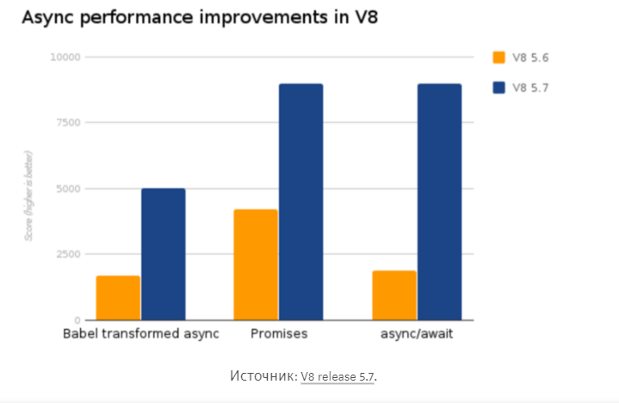

Slide 20
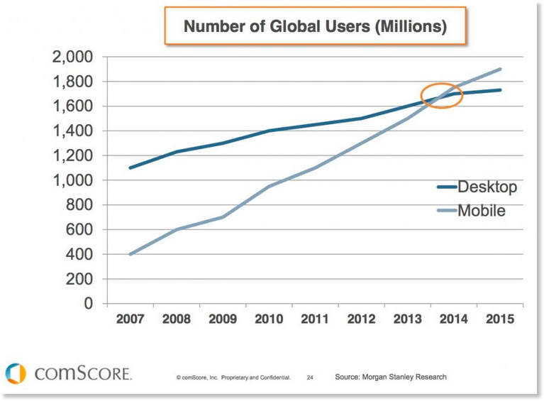

Slide 21
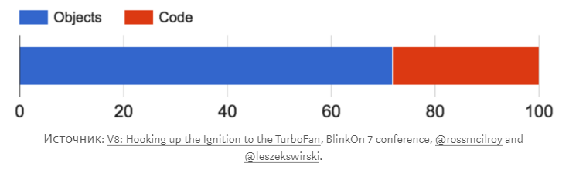

Slide 22
SOURCE CODE
PARSER
FULLCODEGEN
NON-OPTIMIZED CODE
PARSER
CRANKSHAFT
OPTIMIZED CODE
INTERPRETATOR
IGNITION
TURBOFAN
2016

Slide 23
WHY WE NEED AN INTERPRTER
SOURCE CODE
AST
BYTECODE

Slide 24
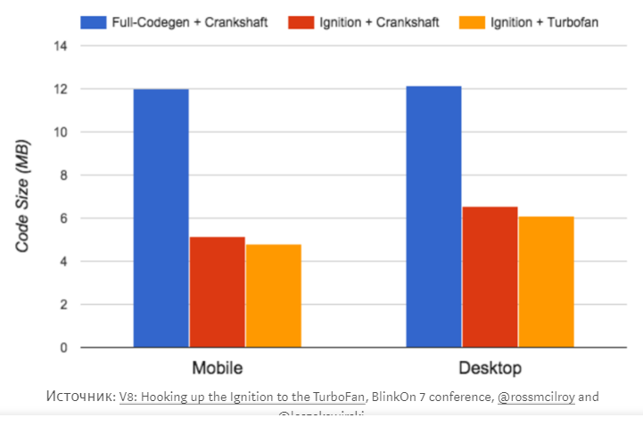

Slide 25
SOURCE CODE
PARSER
IGNITION
TURBOFAN
OPTIMIZED CODE
2017

Slide 26
THANKS!!!
albert.hovhannisyan002@gmail.com

